Slide 1

Enhancement Proposal to the Architecture of
presented via a video summary

Slide 2

Team Members & Contributions
Kabeer Adil
Nicholas Tillo
Group leader
Abstract, Introduction, SAAM Analysis
Presenter
Slides, Impacted Subsystems
Kate Edgar
Raksha Rehal
Use Cases, Testing
Presenter
Voiceover, Feature Overview, Two Implementations
Xiyun Cao
Yu Xuan Liu
Potential Risks
Conclusions,
Lessons Learned

Slide 3
01
OVERVIEW

Slide 4



PROPOSED ENHANCEMENT
A media recommendation system that suggests movies, music, TV shows, live TV channels, etc. based on the user’s previous viewing/listening history. Allowing for curated and accurate suggestions to the user’s interests.
Notes:
The feature that we propose is a recommendation system to provide users with suggestions for media curated specifically to their tastes. There are multiple ways to approach implementation of this feature, to be further discussed.

Slide 5
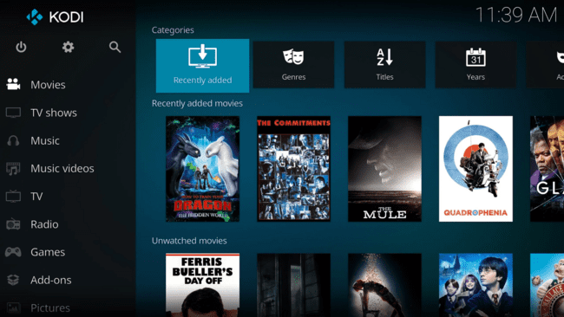
MOTIVATION BEHIND ENHANCEMENT
Expansions always required.
Catch up with other services in the same field.
Highlights KODI’s strengths and encourages use of the system.
Notes:
There are several reasons we chose this feature as the most suitable enhancement for KODI. For one, change is integral in order for softwares to stay in the competitive market. The more modern the system is in terms of its algorithms and functionalities, the more likely it is for users to engage. Hence, having a specialized recommendation feature would put KODI on par with other media services that offer unique recommendations to its users already.

Slide 6
BENEFITS OF EXPANSION
COHESIVITY AND VARIETY
A recommendation system to provide suggestions for all media formats supported by KODI.
MARKETABILITY
Encourages the further use of the system, and repeated consuming of content.
CONTEMPORARY ADVANCEMENTS
Expresses knowledge of the newest levels of technology, encourages users to engage with such a modern system.
Notes:
There are also many benefits that a recommendations feature will offer to both KODI and its users. First, this feature can be applied to a variety of media formats, as one of KODI’s biggest strengths is its ability to support all sorts of media, including movies, TV shows, songs, live TV channels, pictures, and even games. Additionally, having a recommendation feature that allows users to immediately check out the suggested media will keep consumers hooked onto the platform, increasing user engagement with KODI.

Slide 7
02
1ST IMPLEMENTATION APPROACH

Slide 8

GENERATIVE AI IMPLEMENTATION
AUTONOMOUS FUNCTION
UTILIZATION OF MODERN TECHNOLOGIES
Train a model based on individual users’ viewing/listening histories.
AI is the new horizon of technology.
Notes:
The first approach to implement such a feature would be to utilize generative AI to produce recommendations for the user. The model would collect data and create suggestions based on the user’s watch history, while considering factors such as genre, duration of engagement, and metadata of the media content. This would be a great implementation approach as its use would show users that KODI is able to keep up with and employ the latest technological offerings.

Slide 9
USERS
DEVELOPERS
SAAM ANALYSIS
STAKEHOLDERS & NFRS
Security - Ensuring protection of user data as it is used to train the model.
Usability - User gets to specify if and how the AI is used to curate recommendations.
Reliability - Model requires rigorous testing to ensure that there is no interference in other KODI operations.
Scalability - Ensuring that the AI model is able to scale with growing databases and changes.
Maintainability - Keeping the model up-to-date and functional.
Interoperability - Ability for the model to work between different platforms and with different media formats.
Notes:
We performed an SAAM analysis on both approaches, but we will start by considering our findings for the AI-based approach. The major stakeholders we considered were that of the users and the developers. For users, the NFRs they would be most concerned with include the feature’s security, usability, and reliability. Users would want the AI model to use their data safely, and ensure that it is protected. In that same vein, they would also want to ensure that they are able to dictate if and how this model is used, including specifying whether their data is able to be collected, and what media formats they would like to see recommendations for. For seamless user experience, clients would also be concerned about reliability, as they would want to ensure that this new feature does not disrupt their engagement with other features in the KODI system.
As for developers, they would be concerned with the AI model’s scalability, maintainability, and interoperability, as they seek to ensure that the model would be able to scale with growing data- and user-bases, be easy to maintain, and function seamlessly amongst various platforms and with different media formats. Scalability and maintainability are especially important to an AI approach, as the model is complex, and hence we want to ensure that its deployment is not static and may be easily adjustable if needed.

Slide 10
SAAM ANALYSIS
ADVANTAGES & POTENTIAL RISKS
HIGH ACCURACY
Less susceptible to human biases and errors. More likely to meet targets with this model.
LARGE AMOUNTS OF UPFRONT DATA / COST
In order to process and test the model and its data, a large amount of resources are required upfront.
AUTOMATES REPETITION
Does not put the burden of data collection on the users. Improves user experience.
Notes:
The advantages of using an AI model to suggest recommendations include the model being highly accurate, and automating repetitive tasks. Specifically, an AI model would not be susceptible to the errors and biases that humans are prone to. As it carries more precision than a survey-based model, it is more likely to meet goals by suggesting more accurate recommendations. Additionally, repetition is eliminated with the model being based on user data, and not their input. One glaring disadvantage with this approach, however, is the high amount of upfront costs in order to implement an AI-based model. KODI is a free, open-source project, hence budget for the system is a big limitation standing in the way of implementing and maintaining a feature reliant on AI.

Slide 11
03
2ND IMPLEMENTATION APPROACH

Slide 12
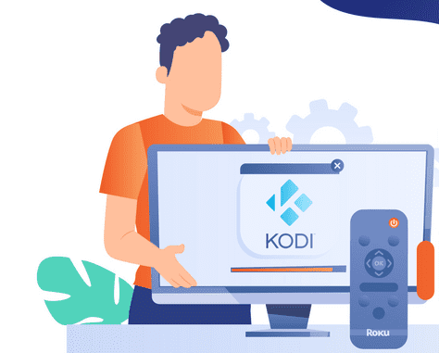
POLL AND DATABASE IMPLEMENTATION
ACTIVE DATA COLLECTION
BACKEND DATABASE
Polls appearing after each movie watched, asking if they would say it is similar.
Database storage with a connection, and frequency High focus speed of sorting.
Notes:
The second approach is to use a data collection system that would survey users’ opinions on other works of media relevant to ones which they consume. Specifically, there may be a pop-up at the end of a movie or song that prompts them to rate how similar said media is to provided options. This will serve almost as a poll system to collect data from the user which will be utilized across KODI systems. A repository-style architecture would be needed to store results from these polls.

Slide 13
USERS
DEVELOPERS
SAAM ANALYSIS
STAKEHOLDERS & NFRS
Security - Depends on user inputted surveys
Usability - User friendly interface with clear instructions. Focus on non-intrusive integration
Reliability - Needs to handle varying user loads for high or low watched movies with accuracy
Scalability - Ensuring that the system can handle large amounts of user-submitted data.
Maintainability - Keeping the model up-to-date and functional.
Interoperability - Flexibility between different platforms and with different media formats.
Notes:
The SAAM analysis for users’ security, usability, and reliability reveal the differences between our two approaches. For security, there is less data in comparison to the AI, meaning that it is more secure, as it does not have sensitive information that it has to store. However, this also reduces accuracy. For usability, deploying the poll would require a user-friendly, intrusive-free interface with clear instructions. For reliability, the implementation is required to be robust enough to handle varying loads without downtime. Additionally, if the system encounters errors, mechanisms should be in place to ensure that data collected is not corrupted.
As for the developers, in terms of scalability, the system should be able to handle large volumes of user submissions. For maintainability, it must also ensure that code is well documented, not over engineered, and contains modular components. For interoperability, similar to the AI approach, it would be pertinent for the data collection system to not be restricted to one device or type of media. Protocols that allow for seamless integration of new technologies are vital.

Slide 14
SAAM ANALYSIS
ADVANTAGES & POTENTIAL RISKS
EASY IMPLEMENTATION AND INTEGRATION
IMPOSING DATA COLLECTION
The backend implementation of the system is straightforward, using many features already implemented.
The data polls can lead to an annoyance creating a negative user experience.
STRAIGHT FORWARD DATA COLLECTION
SUSCEPTIBLE TO BIAS
Little data analysis required, only a simple database and sorting to create the recommendations. Focus on efficiency.
Many factors can create links between movies that should not have a link, for example, similar title.
Notes:
In terms of advantages, development of a polling system and database are much more straightforward than the complex data analysis required to develop and train an AI model, making for easier and cheaper implementation. The data collection process is also much more straightforward, as it depends on user input. For disadvantages however, the implementation requires a polling system to make its recommendations. Requiring users to input data is likely to interrupt the user experience. Additionally, outside sources of bias can taint the data gathered by the polls, as the goal is solely to judge on how similar pieces of media are. For example, a similar poster or title could inaccurately give off the impression that two pieces of media are similar.

Slide 15
04
IMPACTED SUBSYSTEMS

Slide 16
SUBCOMPONENT INTERACTIONS
USER INTERFACES
Most impacted by the new feature; especially in the polling approach. New subcomponents.
ADD-ON MANAGER
Community may create add-ons to enhance the accuracy of the recommendation components.
DATA & FILE MANAGEMENT
Data on watching/listening histories and recommendation results and computations are stored here.
CORE (MEDIA CONTROLLER)
Largely unaffected, aside from the retro player where data may need to be collected to recommend games.
NETWORK (THIRD PARTY CONNECTION)
No impacted directories are projected.
Notes:
The recommendations feature would not be a high-level subsystem on its own, but would rather take form in subcomponents present throughout the other subsystems in the architecture.
The main section that would be impacted is the UI subsystem. The feature would either require a new sub-component called “Polling Manager” or “AI Recommendation”, or it would need to be a child of a preexisting subcomponent. Its responsibility would be to manage the inputs and outputs of both approaches. This feature impacts all directories, mainly the user interfaces and dialogs.
The Data And File Management subsystem is the second most affected. Both approaches require some type of storage mechanism. Using AI requires large amounts of upfront data to train the model, and this would be stored in the data and file manager. Similarly, a database to put polling results would be requires, as well as a system to determine the most accurate results.
The network is the only subcomponent that does not get affected at all, followed by the add-on manager and the cores which barely get affected. Specifically, the add-ons can tweak the implemented approach for better development of other functionalities. For example, it could be used to recommend files to download depending on what was recently downloaded. In terms of the subsystem containing the cores, only the retro player has the potential to be affected in order to recommend games with similar play styles to those enjoyed by the user previously.

Slide 17
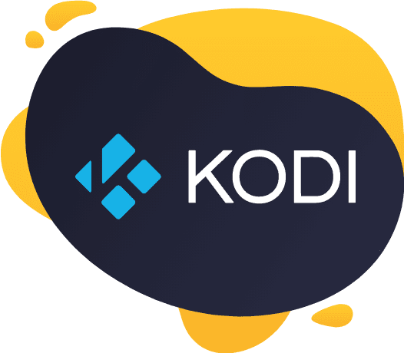
SUBCOMPONENT INTERACTIONS
UTILITIES
PERSONAL VIDEO RECORDER
Code blocks to assist the functionality of the implemented model.
Metadata from recordings can be used to train the AI model.
Notes:
The PVR is also largely unaffected, however this system can be changed to better assist the data collection for either implementation method. For example, those who tend to take recordings using the PVR are more likely to share a communally enjoyed trait, such as a genre. This information can be used to train the AI, or strengthen connections within the database.
Lastly, utilities are affected as new functionalities to assist either implementation method will be harboured within this subsystem. In addition to this, testing code and miscellaneous data related to the models employed will be located here.

Slide 18
05
POTENTIAL RISKS

Slide 19

RISKS VIA AI IMPLEMENTATION
CONCERNS WITH DATA
Ensuring data privacy, worries about redundant data, etc.
RESOURCE SCALABILITY
Scaling the AI model and ensuring modularity will be costly and tedious due to its complex nature.
ALGORITHM BIAS
Risk of bias in the model due to its dependency on human-generated data.
Notes:
After completing the SAAM analysis and analyzing each approach, our group determined that the one suited to realize our proposed enhancement is the AI-based model. We have already discussed the pros and cons of this approach, however we will go in depth in regards to the potential risks and limitations of this approach here…
Firstly, data privacy is a major concern for any service that requires data collection. If data is attained without rigorous security measures, the system would be prone to data breaches and leaks of information, leading to loss of trust and privacy amongst the users of KODI.
Secondly, the constant collection and usage of data that is required for consistent upkeep of the model requires a large amount of storage space. This can get costly for the user and decrease the overall scalability of the system by hogging their resources, introducing lag, or even haulting performance.
Lastly, depending on the source of the training data, the AI method has a chance of introducing biases, resulting in the creation of inaccurate connections.

Slide 20
06
TESTING

Slide 21

PLAN FOR TESTING
Testing focused on installation and configuration of procedures.
For early useability and accuracy testing subset of recommendations will get created.
Enhancement will be rolled out gradually for reliability, scalability and maintainability.
Notes:
The testing plan for the proposed AI approach focuses on seamless integration and positive user experience. The primary testing stage would be focused on installation, ensuring a smooth deployment. For early usability and accuracy testing, we will provide the AI with a limited subset of movies. The system will categorize these movies, allowing for manual evaluation of accuracy. To enhance the scope of this testing, we will request user feedback, using methods such as a thumbs-up or thumbs-down system, further increasing accuracy. Security testing will evaluate the impact on user privacy, with emphasis on the anonymization and encryption of sensitive information. For reliability, scalability and maintainability testing, we would roll out this enhancement to users in a very gradual fashion.

Slide 22
07
USE CASE

Slide 23
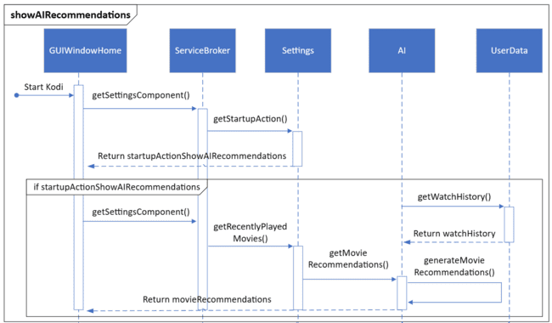
KODI RECOMMENDATION USE CASE
Use-case for displaying recommendations on user’s landing page.
KODI starts up, and the AI gets invoked.
Watch list is created from previous watch history.
The AI consults this information and returns a list of recommendations.
Notes:
The following use case highlights the main feature provided by our proposed enhancement; that is, providing recommendations on a user’s homescreen. The GUIWindowHome component is launched on startup and interacts with the Service broker, which then calls settings to compute all the startup actions required by KODI. One of these actions is the “start up” action which calls the “show all recommendations” function. This function interacts with the AI model, which itself gathers a previously generated watch history, using it to return a list of movie recommendations back to the GUIWindowHome.

Slide 24
08
LESSONS LEARNED

Slide 25
MAIN LESSONS LEARNED
IMPORTANCE OF MARKET ANALYSIS
IMPORTANCE OF USER EXPERIENCE
VIABILITY OF AI TOOLS
Incorporating other good functionalities common in part of other applications within the same market to improve.
The disruptive nature of data collection proves the importance of focusing on user experience in a service based program.
AI tools are a viable alternative for other taxing, the burgeoning technology is interesting topic to explain in more stagnant markets.
Notes:
We have come across several important realizations while proposing our enhancement to the KODI system. Firstly, we’ve come to discover the importance of incorporating functions commonly found as a part of the app’s contemporaries. This would improve the credibility of KODI, as it would be comparable to current industry standards. However, we also realized that the methodology involving active data collection is far more disruptive of user activities and sacrifices accuracy due to the lack of reliability and security. This is how we determined that the AI approach is more viable than the polling approach.

Slide 26
CONCLUSION
By implementing a recommendation system using artificial intelligence, we could enhance KODI’s user experience, done through passive data collection and analysis to curate the most accurate and relevant recommendations to increase usability, reliability and improve the desire to consume content.
Notes:
Over the course of this project, we broke down the architecture of KODI to its very bones. After gaining a solid understanding of the way this system and its components function and interact, we were able to propose an enhancement that plays on KODI’s strengths and offers a variety of benefits for both the system and its users.

